Slide 1
Category review: Chips
June 2020
Retail Analytics
Brand note: If client logo is not required, use alternate title page layout right click slide thumbnail > Layout > Title

Slide 2
Notes:
To view Privacy video explaining how important data privacy is to Quantium, please click here: https://www.youtube.com/watch?v=Zq1QDAkoRzU
or here Q:\Company Reference\Brand & Design\Brand videos\Q Privacy.mp4
At Quantium, we believe that data is the behavioural footprint of humanity and that it has to be treated with the utmost care and responsibility.
Histories, attitudes, indeed lives are stored within it in ways that aren’t always apparent – and that’s what makes its potential so powerful.
To work with it responsibly, sensitively, we set ourselves the highest data privacy protection and governance standards.
We have spent 17 years perfecting privacy-by-design and secure-by-design principles. Central to this is not holding any personally identifiable information about people –
we neither receive it, and put the necessary protections in place to be unable to decipher it.
Every aspect of handling data is safeguarded: from its de-identification, to its encryption – data security is paramount and of the highest grade.
We pride ourselves on gaining the trust of iconic organisations around the world through years of securely working with their data,
and in turn the trust that builds with their stakeholders.

Slide 3
Executive summary
01
Task 1
The Mainstream category of Young and Mid-age Singles/Couples have the highest spending of chips per purchase.
The Older Families have the highest frequency of purchase followed by Young Singles/Couples and at last Retirees contributing to a total 25% sales revenue.
Chips Brand Kettle is the most purchased brand in all stores.
Young and Mid-age Singles/Couples is the only segment having Doritos as the highest purchase brand while Smiths is for other segments.
Most purchased chip size is 175 gr followed by 150 grams.
Transactions increase a lot before Christmas which can be because of holidays season and a lot of making and promotions.
02
Task 2
Trial stores 77 and 86 have significant increase in total sales and number of customers during trial as compared to control store.
Trial store 88 had increase as well but not as good as stores 77 and 86

Slide 4
01
Category

Slide 5

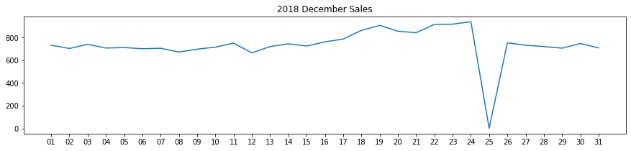
As Christmas day draws near, sales gradually grow. On New Year's Eve, they resume their early December levels.
Christmas day is the day with no transactions since the business is closed; as a result, there was a drop in sales on December 25th.

Slide 6
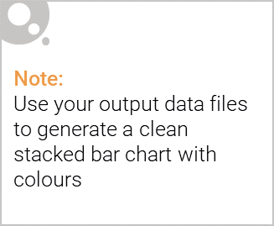
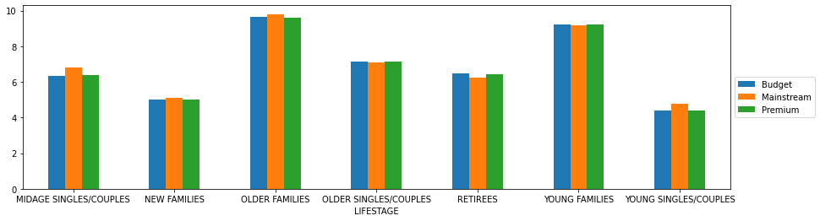
Editable (delete this)
Budget - older families, Mainstream - young singles/couples, and Mainstream - retirees accounted for the majority of sales. generating 25% of the entire sales income.
The segments with the greatest average purchase units per unique client are Older and Young Families.

Slide 7
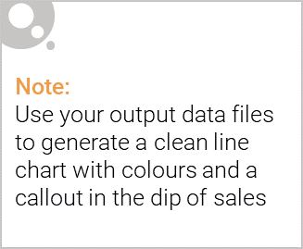
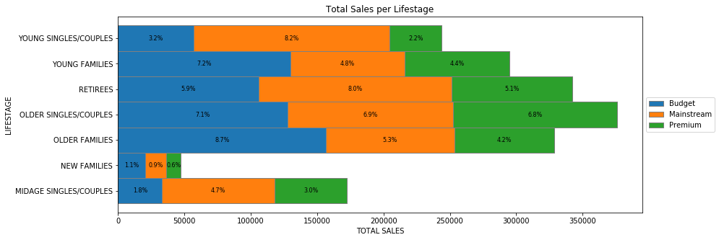
Budget - older families, Mainstream - young singles/couples, and Mainstream - retirees accounted for the majority of sales. Overall, older clients spend more money than younger ones. Customers who do not pay a premium purchase more than those who do.

Slide 8
02
Trial store performance

Slide 9
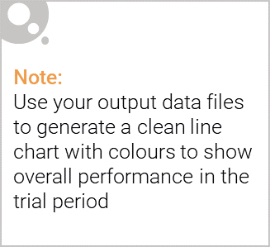
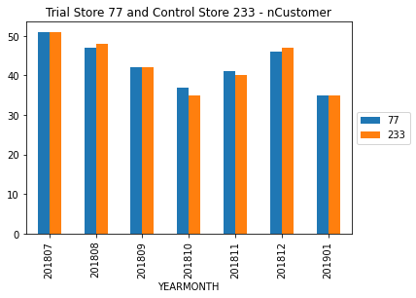
We can observe that the trial store's 77 sales in February, March, and April exceeded the control store's 95% criterion. The same is true for shop 86 sales during the three trial months.
Trial Store 88's sales growth, however, is negligible.

